Slide 1

Library
Starter Kit
Compiled by
Helene van der Sandt

Slide 2
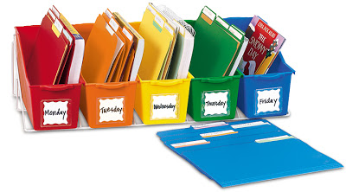
Contents of Starter kit
Library membership: Registering, borrowing, etc
Online presence: Library Web Page, Social media
Facilities: wifi, photocopiers, computers
Information resources: Classic Catalogue, FindPlus, InfoWise, Online Databases

Slide 3
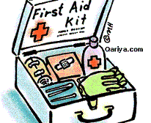
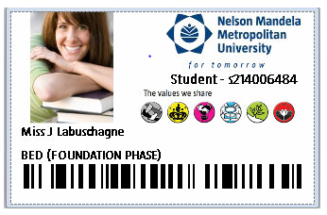
Library membership
Renewing books
Borrowing books
Overdue Charges
Short Loans

Slide 4
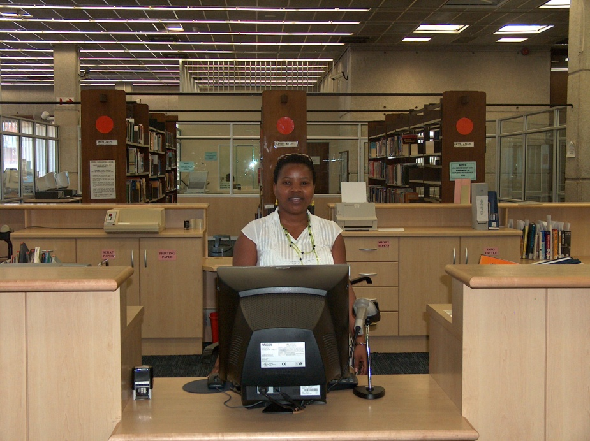


What must I do to become a library member?
Please do not let other students use your student card.
You are responsible for all items issued on your card.
Please register as a LIBRARY USER
at the Circulation Desk.
Bring your student card to register
for first time and every year there-after.
Provide 2 different contact numbers.
No CARD
= No Library entrance
= No books on loan
= No computers
= No Services

Slide 5
borrowing from library
Patron type | No. of items | Loan period
First – Third year students | Total items = 10 | 14 days
Fourth – Fifth year students | Total items = 15 | 30 days
Distance Undergraduates | Total items = 10 | 30 days
Masters & Doctoral/Post-Doctoral students | Total items = 20 | 60 days
Academic & Research staff | Total items = 30 | 90 days
Admin & Technical staff | Total items = 15 | 30 days

Slide 6
Renewing of items
Patrons may renew library material
  by phone,
  online via the Classic Catalogue or
  in person at the Circulation Desk.
Library material can be renewed once unless another patron has requested the item.

Slide 7
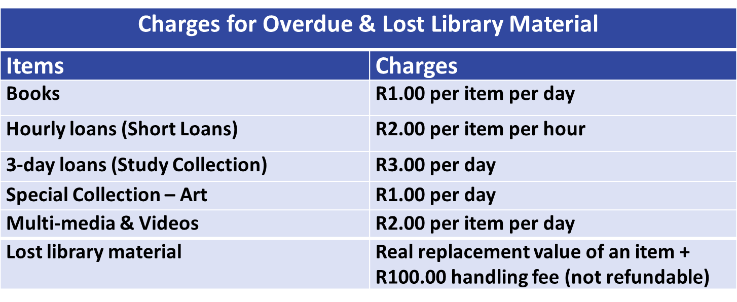

OVERDUE / LOST CHARGES
This overdue charge will change to a billing fee of R100 per book once the book is more than 30 days overdue.

Slide 8
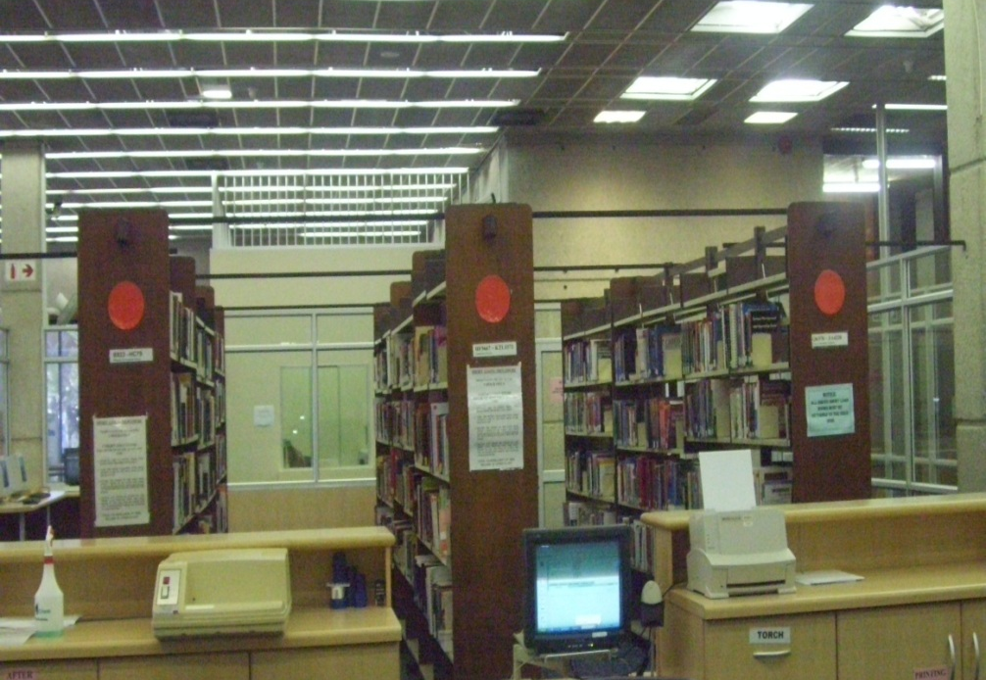
SHORT LOANS / COURSE RESERVES
Books, articles or class notes placed by the lecturer
You must have:
    Student card
    Shelf no. of the item, looked up in Classic Catalogue
Items can be used for 1 hour at a time
One renewal in person per item, provided another student has not booked the item
Short Loans are behind Circulation Desk
on Ground Floor
Notes:
Refer to p. 8

Slide 9
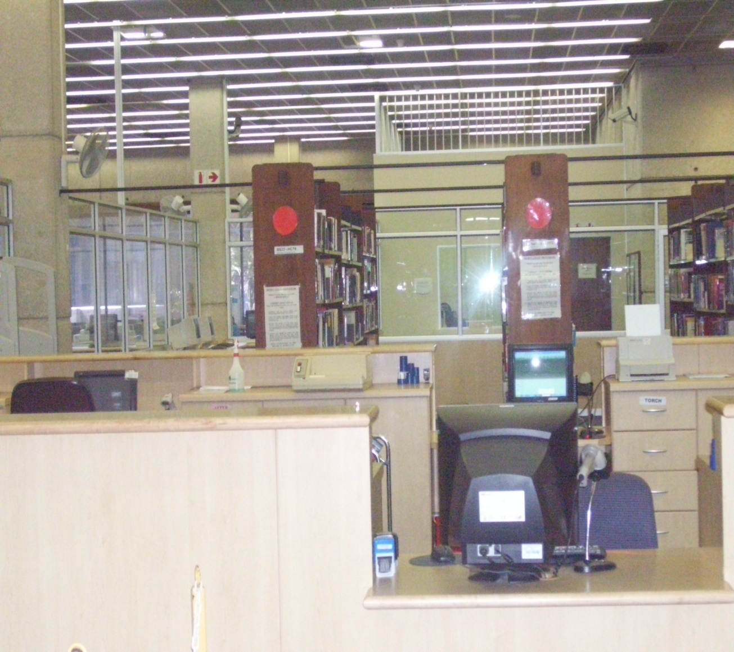
STUDY COLLECTION
Copies of prescribed books
May be borrowed for 3 days
No renewals or reservations for this collection
Study Collection is also behind Circulation Desk on Ground Floor
Notes:
p. 8-9

Slide 10

Library facilities

Slide 11
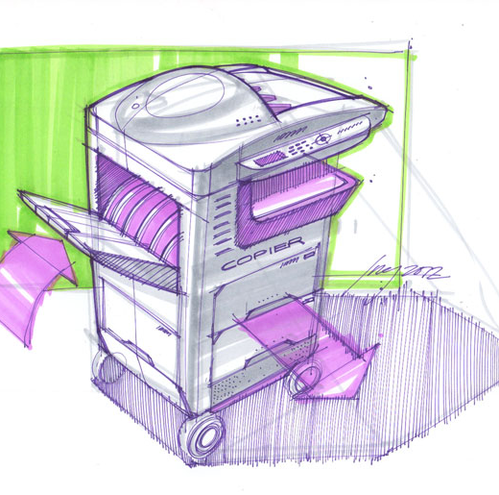

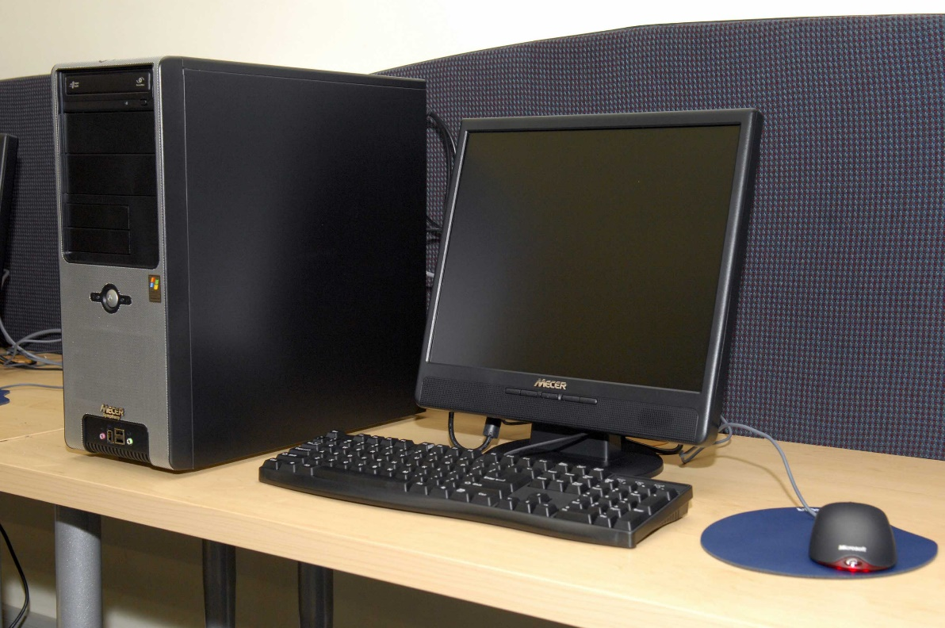

Facilities
Copiers/printers on all floors. Use the same system as in labs.
S
Special needs
4 dedicated (wheelchair friendly) workstations
Magnifier
Zoom Text software
Special keyboards with large icons, a dedicated scanner and printer
Computer Work Stations issued 1 hour at a time.

Slide 12



Online presence

Slide 13
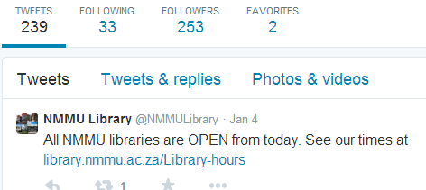
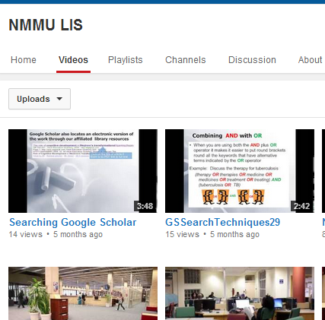
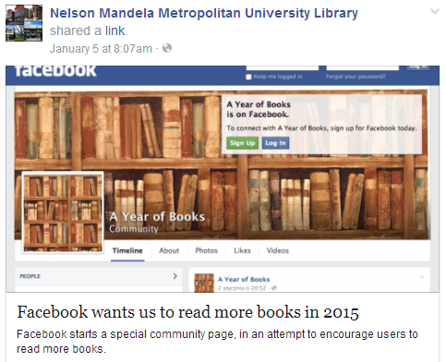
Social media
Twitter
http://twitter.com/NMMU
NMMU Library onTube
http://www.youtube.com/user/NMMULibraryonTube
Facebook:
http://www.facebook.com/NMMULIS

Slide 14
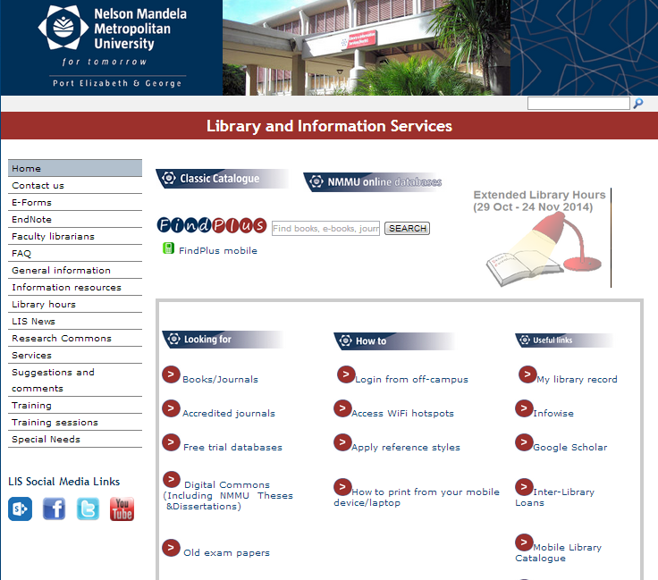
Library website:
http://library.nmmu.ac.za
Quick Links
Menu
Library training sessions

Slide 15
On the Librar site you wil find:
Links to
Information Resources:
  Classic Catalogue
  FindPlus
  Online Databases
  InfoWise
  Google Scholar
  Old Exam Papers
  Mobile Library Catalogue, etc.
Information about:
  Library Hours
  Library training sessions
  Information Commons
  E-forms
  Photocopying and Printing
  Inter-Branch Loans, etc.

Slide 16

Information resources
NMMU Online Databases
Classic Catalogue
FindPlus
InfoWise

Slide 17
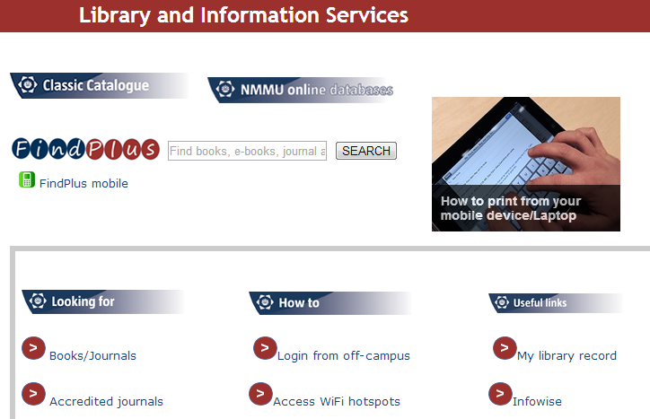
Information resources: starter kit
Find books, articles and class notes placed in the Reserve/Short Loan Collection.
Create a PIN to access off campus resources, etc.
Do a quick search for books.
Databases contain information (citations, abstracts and/or full text) of journal articles, reference works and other documents
InfoWise provides information on how to do assignments.
You can search multiple Library resources (books, journal articles) all at once with a “Google-like” search.

Slide 18
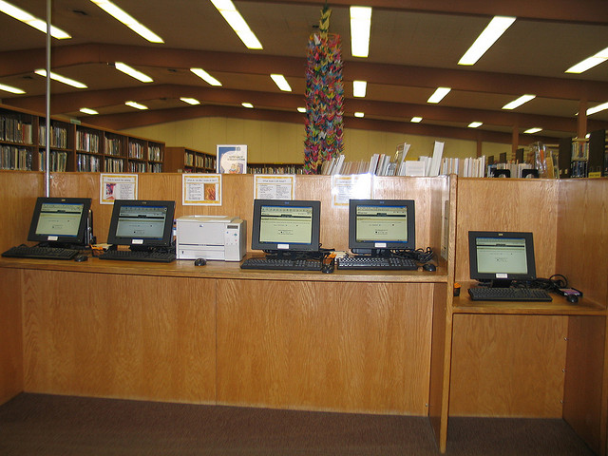
Classic catalogue

Slide 19

Find Classic Catalogue on Library Website

Slide 20
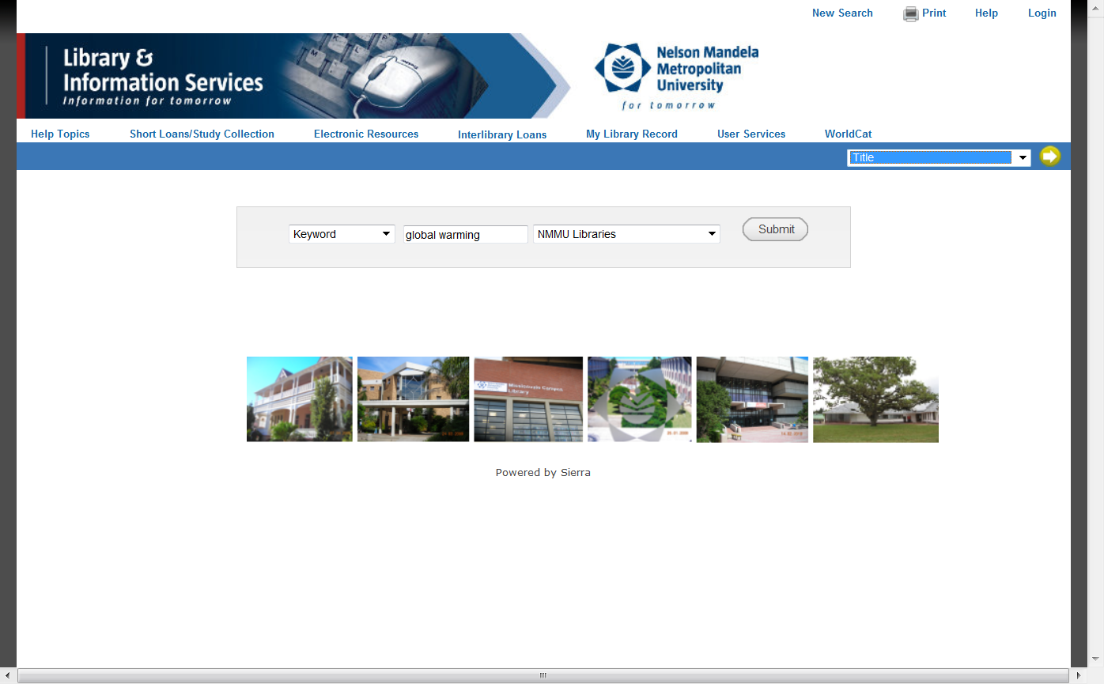
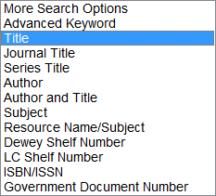
Classic Catalogue: Search Functions
You can do a keyword search on a topic (Like a Google search)
You can also search the catalogue by author, title, journal title, etc. Remember to click on the button.

Slide 21
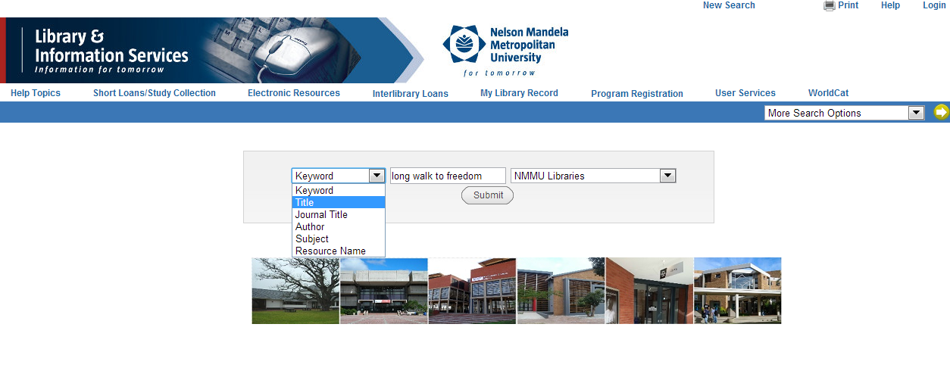
Example: title search in the classic catalogue

Slide 22

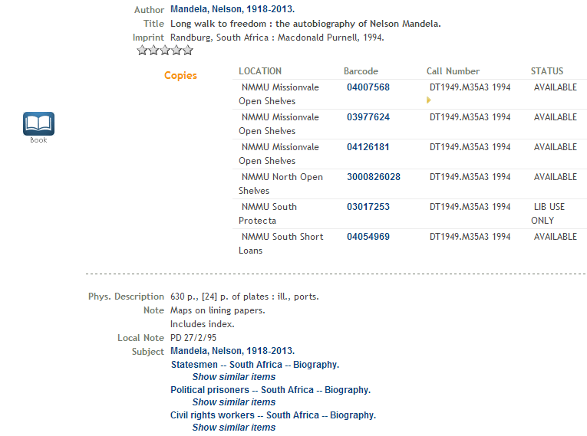
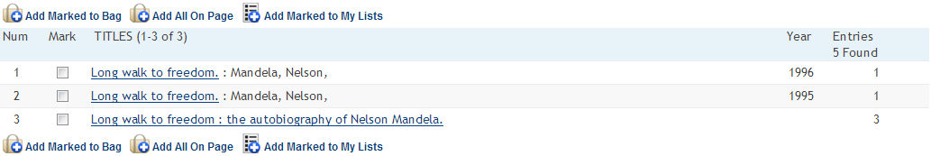
Classic catalogue: title search results
When you've found an item in the library catalogue, be sure to note:
Call Number
Collection (Location)
Be sure it is available for checkout (Status)

Slide 23

Finding An item on the shelf with the call no

Slide 24
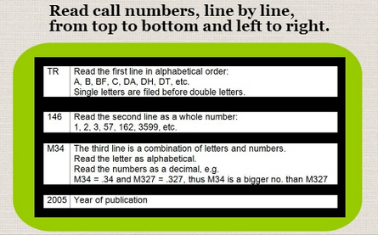
Reading call numbers
r

Slide 25
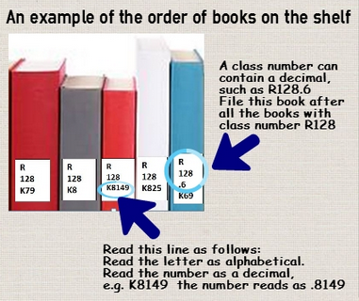

Slide 26

classic catalogue looking up short loans / course reserves

Slide 27
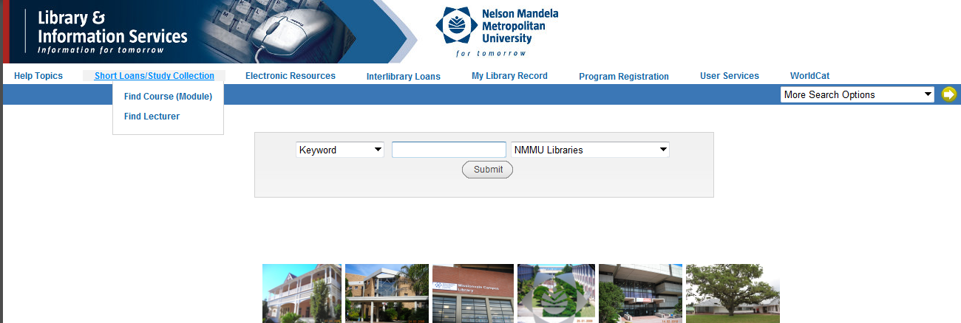
Access Short Loans/Course Reserves
You can either search by course code or by lecturer’s name

Slide 28
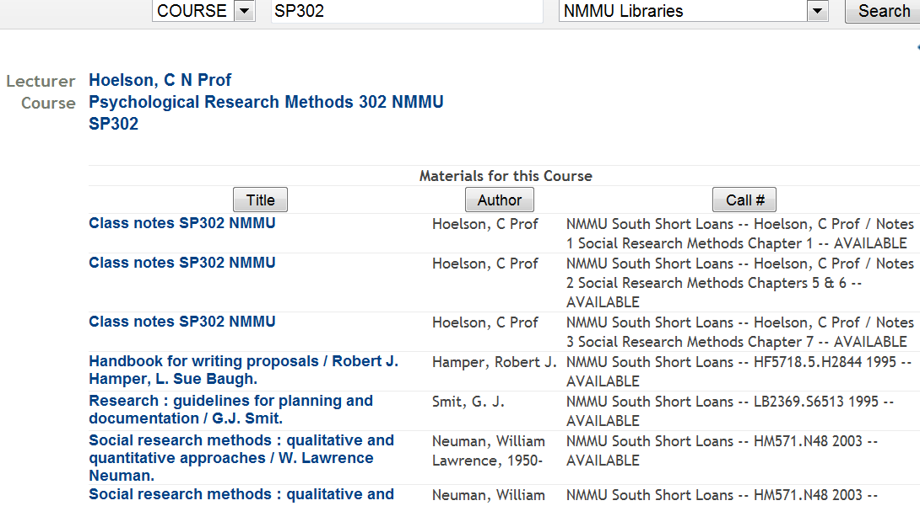
Example of items on Short Loan
You need the following information:
  Lecturer’s name
  Books: shelf no.
  Articles, class notes: box no.

Slide 29

How to create a pin in the classic catalogue

Slide 30
With a Library PIN:
You can request items that are out on loan
You can request items from other Campuses
You can view full records in FindPlus when you are off campus
You can access the Library’s databases when you are off campus

Slide 31

You first need to register @ Library
You must register at any NMMU Library with your valid student/staff card
Students must register at the Library at the beginning of each academic year

Slide 32
Go to Classic Catalogue

Slide 33
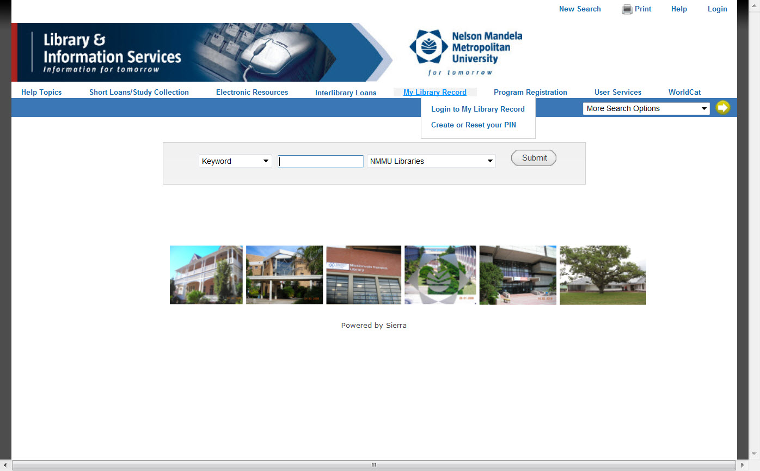
Creating a pin
Click on: Login to My Library Record

Slide 34
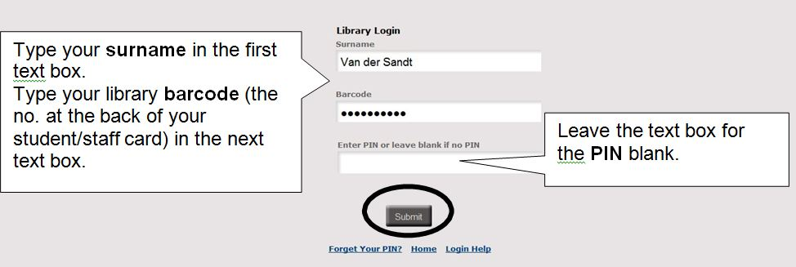
Creating a pin

Slide 35
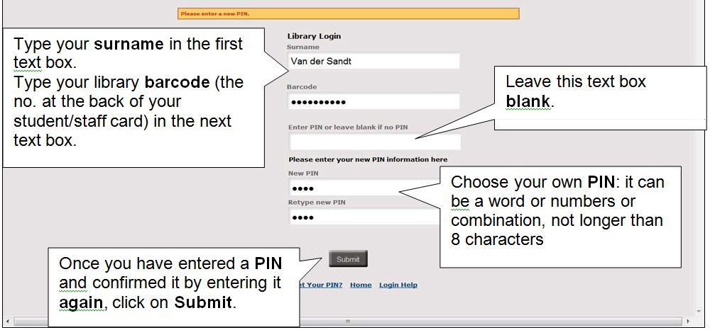
Creating a pin
The next screen will show your Library record. You can now click on at the top of the screen

Slide 36
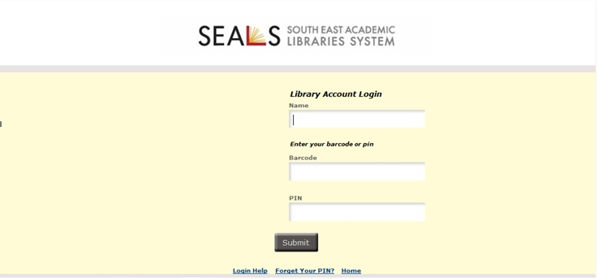
Off campus access with library pin
When you search FindPlus and Nmmu databases off campus and you click on certain tabs, the system will ask you to verify yourself on a screen similar to the one below.
You have to enter your details as well as the PIN you created in the Classic Catalogue.

Slide 37

Find books articles etc in findplus

Slide 38
Do a search in FindPlus

Slide 39


search findplus
Enter a word or phrase in the Search text box, and then press
Search Terms
You can enter an author's name, a title, or keywords describing a subject.
FindPlus returns a list of all the library resources that match your search terms.

Slide 40
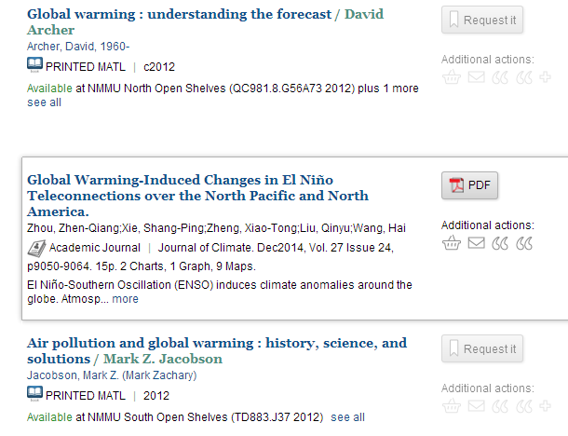
Findplus: Search results
Printed Material (see next slide).
Online journal article.
Click on PDF to view.

Slide 41
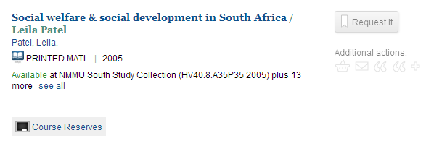
Search result list: printed material
4.
1.
2.
3.
Text and/or icon to indicate the type of material.
When multiple copies are available, the list does not appear until you click the title or
This icon displays if one or more of the copies is on Short Loan or Study Collection.
You can request material from other Campuses and “out on loan” copies.

Slide 42
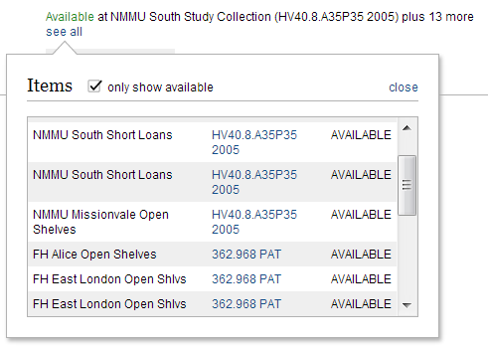
findplus : multiple copies of print material
1.
2.
4.
3.
Untick this option to view all copies.
Check the Campus library (e.g. NMMU South, etc.) as well as the collection (e.g. Short Loans, Open Shelves, etc.) in which the item is.
Copies at other academic institutions in the Eastern Cape, will also display.
Write down the call number (shelf address) of the item to be able to find item on shelf.

Slide 43
InfoWise

Slide 44
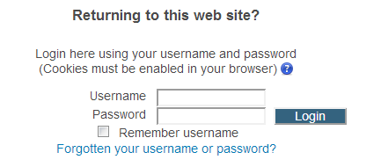
InfoWise: Login with your
NMMU username and password

Slide 45
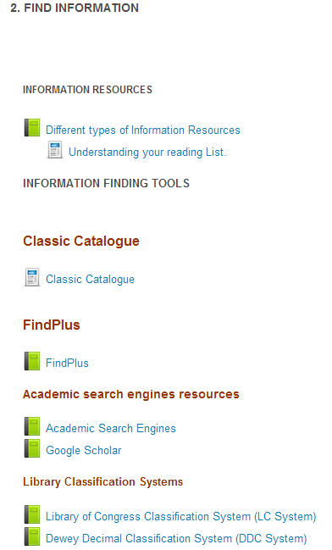
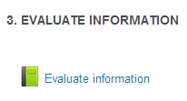
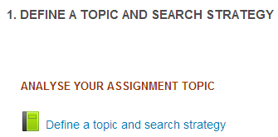
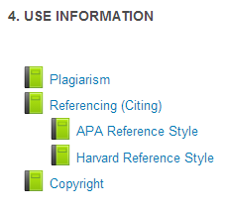
InfoWise
Content

Slide 46
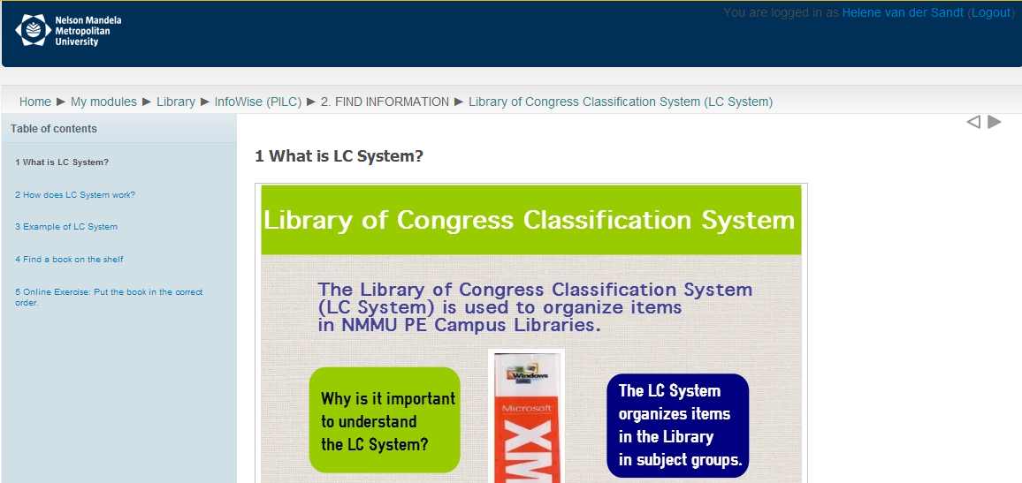
InfoWise

Slide 47
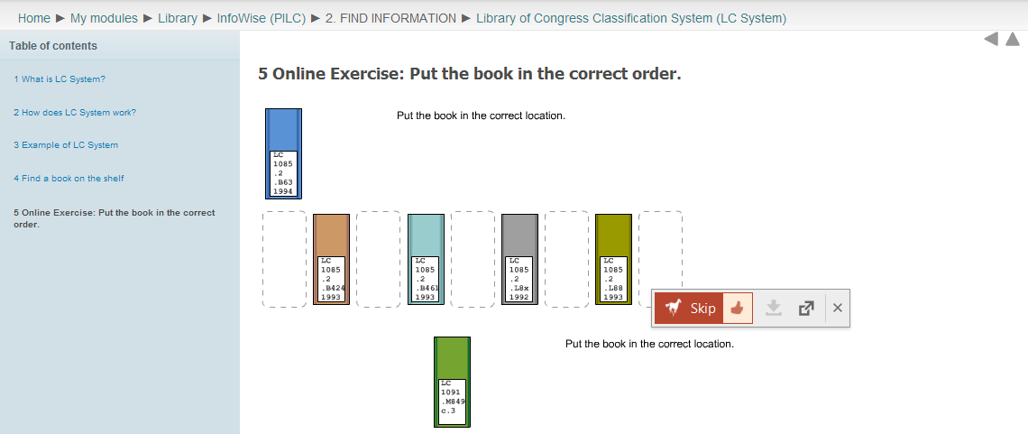
InfoWise: Online Exercise

Slide 48
NMMU Online databases

Slide 49
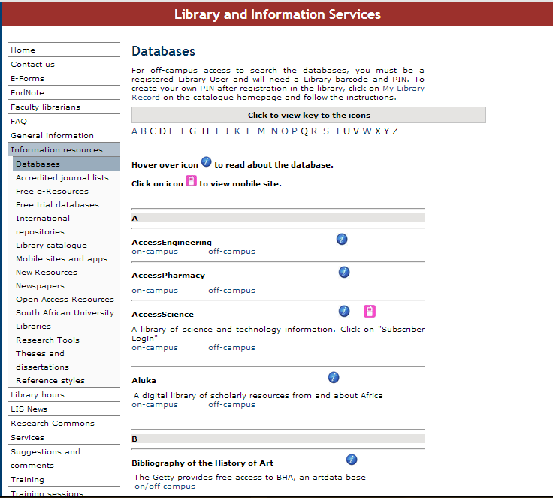
Library Databases:
The NMMU Library subscribes to various selected databases with scholarly publications.
Most of these resources can be searched on-campus and off-campus unless otherwise indicated.
For off campus access you need a Library PIN.

Slide 50


